Slide 1
ETHICAL RESEARCH
Guidelines and Protections
© Eileen Callahan 2010

Slide 2
Why is it important?
Whose responsibility is it?

Slide 3
Shared Values
Honesty
Accuracy
Efficiency
Objectivity
- Conveying information truthfully and honoring commitments
- Reporting findings precisely and taking care to avoid errors
- Using resources wisely and avoiding waste
- Letting the facts speak for themselves and avoiding improper bias
Steneck, Nicholas H., ORI Introduction to the Responsible Conduct of Research, DHHS, 2007

Slide 4
Rules
Professional Ethics
Government Regulation
Institutional Policies
Personal Responsibility

Slide 5
Responsible Conduct of Research (RCR)
Ten Key Areas
  Data Acquisition, Management, Sharing and Ownership
  Conflicts of Interest and Commitment
  Publication Practices and Responsible Authorship
  Mentor/Trainee Responsibilities
  Peer Review
  Collaborative Research
  Research with Human Participants
  Research with Animal Subjects
  Research Misconduct
  Fiscal Responsibility and Stewardship of Resources

Slide 6
Federal Agencies
ORI (Office of Research Integrity)
OBA (Office of Biotechnology Activities)
USDA – APHIS (Animal and Plant Health Inspection Service)
OLAW (Office of Laboratory Animal Welfare)
OHRP (Office for Human Research Protections)

Slide 7
Research Compliance at the
College of Charleston
  Institutional Animal Care and Use Committee (IRB)
  Institutional Review Board for the Protection of Human Research Participants (IACUC)
  Institutional Biosafety Committee (IBC)
These committees assure compliance with regulations concerning research through
    Institutional policies
    Standard procedures
    Review of research projects
    Reporting to government regulatory agencies

Slide 8
Research Involving Biohazards
The IBC is comprised of faculty and staff who have expertise and interest in research involving recombinant DNA and biohazards. It includes scientists and two community representatives who is not affiliated with the College.
The purpose of the IBC is to ensure the protection of personnel, the community, and the environment by mandating safe handling, storage, and disposal of potentially biohazardous materials, including registration of all recombinant DNA research and instructional activities.

Slide 9
Research Involving Animal Subjects
The IACUC is a committee of faculty and staff who have expertise and interest in animal welfare. It includes scientists, the veterinarian, at least one non-scientist and a community representative who is not affiliated with the College.
The IACUC is charged with the responsibility to assure that no animals are used unnecessarily for research or instruction and that every effort is made to insure animal well-being and to minimize pain and distress.
The IACUC reviews all uses of VERTEBRATE ANIMALS - classroom, breeding, holding, and research in the College buildings and in the field.

Slide 10
Research Involving Human Participants
The IRB is a committee of faculty and staff of the College who have expertise with human participant research, plus a representative of the community who has no affiliation with the College.
The IRB reviews all research with living individuals about whom an investigator conducting research obtains
  1) data through intervention or interaction with the individual or
  2) identifiable private information.

Slide 11
What makes it research?
Definition from the federal regulations:
A systematic investigation, including research development, testing and evaluation, designed to develop or contribute to generalizable knowledge.

Slide 12
Why?
Tuskegee Syphilis Study
Nazi Experiments
Human Radiation Experiments
Milgram Study
Stanford Prison experiment
University of Pennsylvania Gene Transfer Experiment
Pharmaceutical Clinical Trials in Developing Countries

Slide 13
Ethical Principles - Applications
The Belmont Report, Ethical Principles for the Protection of Human Subjects of Research, April 18, 1979.
Respect for Persons
Respect Individual Autonomy
Protect Individuals with reduced autonomy
Beneficence
Maximize benefits
Minimize harms
Justice
Equitable distribution of research burdens and benefits
Informed Consent
Privacy & Confidentiality
Risk/Benefits Analysis
Scientific Merit
Review of Subject Selection

Slide 14
Data Acquisition, Management, Sharing and Ownership
Data collection
Data storage
Privacy and confidentiality
Data ownership

Slide 15
Publication
Appropriate credit and acknowledgements
Co-authorship
Citations
Description of methods
Corrections and retractions

Slide 16
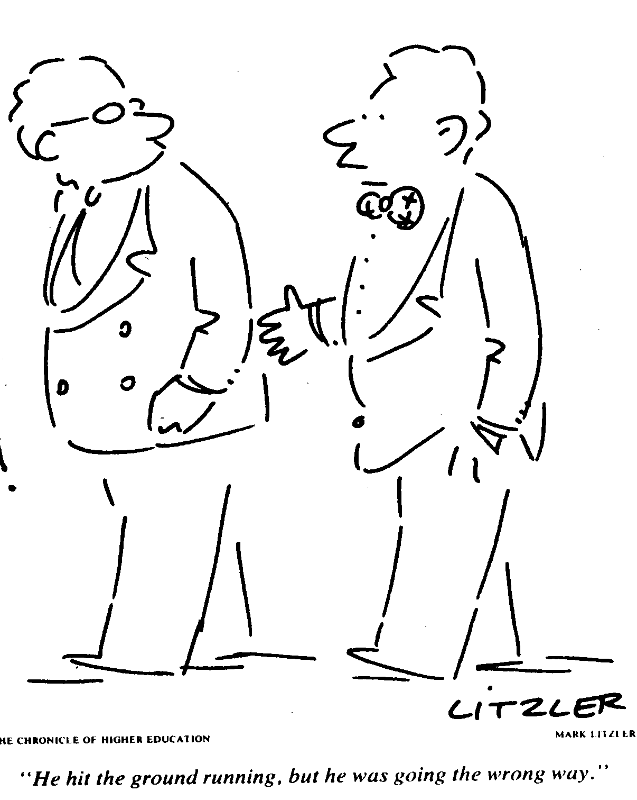
So, what goes wrong?

Slide 17
Research Misconduct
Fabrication - Making up data or results and recording or reporting them.
Falsification - Manipulating research materials, equipment, or processes, or changing or omitting data or results such that the research is not accurately represented in the research record.
Plagiarism - The appropriation of another person's ideas, processes, results, or words without giving appropriate credit.
Office of Research Integrity

Slide 18
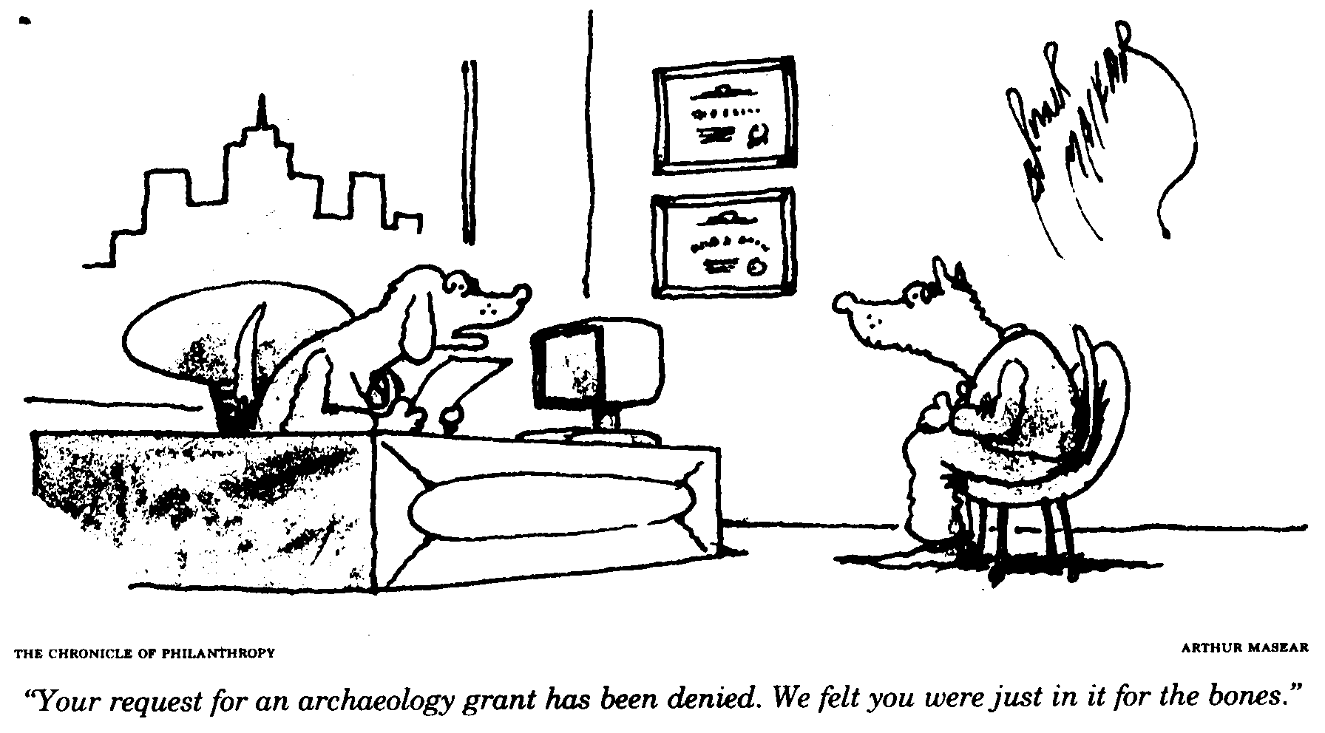

Slide 19
Conflicts of Interest & Commitment
Financial conflicts
Obligations to others – businesses, family - balancing responsibilities

Slide 20
References
Steneck, Nicholas H., ORI Introduction to the Responsible Conduct of Research, DHHS, 2007
Bronowski, J., Science and Human Values, Harper & Row, 1965
Dunn, C.M. & Chadwick, G.L., Protecting Study Volunteers in Research, Thompson Centerwatch, Boston, MA, 2002
Collaborative Institutional Training Initiative
On Being a Scientist, National Academies of Science, 1995
Avoiding plagiarism, self-plagiarism, and other questionable writing practices: A guide to ethical writing

Slide 21
Resources - Tuskegee Study
U.S. Public Health Service Syphilis Study at Tuskegee, Center for Disease Control and Prevention (CDC)
Brody, H., Faces of Tuskegee
Jones, James H., Bad Blood: The Tuskegee Syphilis Experiment, New York: The Free Press, 1993 (expanded ed.)
Gray, Fred D., The Tuskegee Syphilis Study, Montgomery, AL: Black Belt Press, 1998.
Miss Evers Boys, 1997, movie made for HBO
An Apology 65 Years Late, Jim Lehrer NewsHour, PBS

Slide 22
Resources – Milgram and Zimbardo
The Stanford Prison Experiment, 2002, BBC Documentary
Dr. Thomas Blass presents Stanley Milgram.com
Stanford Prison Experiment web site
Zimbardo, Philip G., The Lucifer Effect: Understanding how good people turn evil, New York: Random House, 2007
The Constant Gardener, 2005 (movie)

Slide 23
Eileen Callahan
Research Protections & Compliance
Office of Research and Grants Administration
College of Charleston
407F BellSouth (AT&T) Building
81 St. Philip Street
843-953-7421
callahane@cofc.edu
compliance@cofc.edu
http://www.orga.cofc.edu/pub/compliance_index.shtml

